Slide 1
Modern Rhetoric
September 25, 2017
AP English 3
Mr. Bell

Slide 2
Rhetoric
The Art of Persuasion

Slide 3
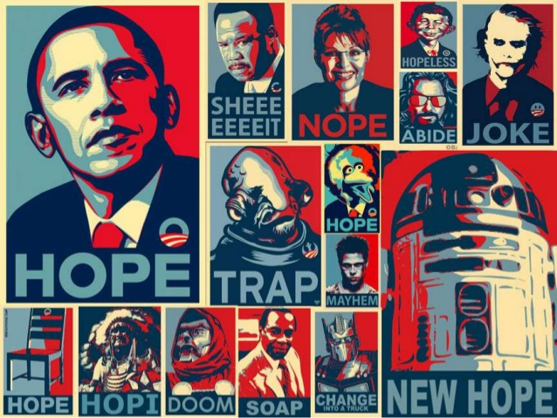

Slide 4
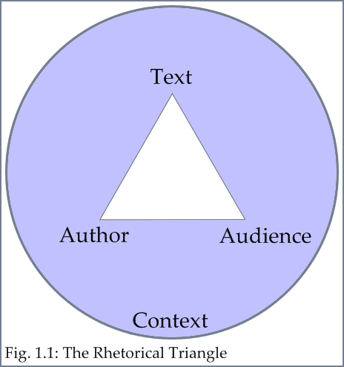
The Rhetorical Triangle
Writer (Ethos)
Audience (Pathos)
Message (Logos)
Purpose
Rhetorical Context

Slide 5
Writer
The writer must ask the question: “What can I do to build my credibility and make the audience trust my message?” You must address tone, style and deal with counter-arguments.

Slide 6
Audience
To have a message accepted by the audience, the writer should try to appeal to their emotions, which is why the audience is often linked with pathos in the rhetorical triangle. The writer must ask, “What values and beliefs do I appeal to in the audience? How can I engage both the audience’s heart and mind?” The more you know about your audience, the better you will be able to find what appeals to their emotions.

Slide 7
Message
In the rhetorical triangle, message is often linked to logos, the content of the communication. People sometimes confuse logos with logic. The logical argument is certainly an important component of logic; however; logos involves the entire content of the message. Ask yourself, “What assumptions support the reasoning? What is the evidence?

Slide 8
Balance
If you put too much emphasis on message, you risk forgetting about the audience or establishing yourself insufficiently.
If your emphasis is too much on the emotional appeal to the audience, then the content of your message might suffer, or the audience might not trust you.
If you focus too much on yourself as the writer, then you might be dismissed as an egotist or a blowhard.

Slide 9
Purpose and Occasion
The purpose of your communication is your rhetorical goal.
Rhetorical Context (Occasion): The background to which a persuasive message is addressed is considered rhetorical context. As the rhetorical situation changes, so should the response. Aritstotle refers to the rhetorical context as those proofs that are inartistic or extrinsic because they are not under the control of the writer and do not emerge from the writer’s creative efforts.

Slide 10
Stephen Toulmin
In 1958, Stephen Toulmin published a book titled The Uses of Argument, which has greatly influenced the study of both analyxing and creating arguments. Toulmin’s scheme was developed for use in the courtroom as a practical tool for persuading judges and juries. The model does not attempt to prove, but it gives good reasons and persuasive arguments.

Slide 11
Claim
Claim: In the Toulmin scheme, a claim is a statement of position, a stand, or what you may have come to know as a thesis statement. A claim is an arguable statement. It is not a statement of the obvious, it presents an issue about which reasonable people might disagree.

Slide 12
Reasons
Reasons support the claim. An individual claim may have many supporting reasons for an argument.

Slide 13
Warrant
The warrant is the unstated assumption that makes the enthymeme work. The audience must accept the warrant in order to find the argument persuasive. The warrant is often the most vulnerable part of an argument because it appeal to the values and beliefs of an audience, which can be difficult to determine.

Slide 14
Toulmin
Grounds: Claims, reasons, and warrants represent an argument in broad outline, stated in phrases or sentences, Of course, arguments involve much more than this. The grounds provide the actual evidence in the support of the reasons. Grounds includes facts, citations from authorities, examples, and statistics. Well stated grounds make reasons more concrete for an audience.
Backing: Supports the warrant. If an audience already accepts the unstated assumption or warrant, then backing is unnecessary. However, if the person making the argument is unclear about the warrant or unfamiliar with the values and beliefs of the audience, then the writer must provide backing to support the warrant.

Slide 15
Toulmin
Conditions of Rebuttal: No argument is complete without anticipating the counter-arguments, and the conditions of rebuttal will bring up and address those counter-arguments. Rebuttal attacks the reasons and grounds and/or the warrant and backing.
Qualifier: A qualifier limits the claim. In the real world there are few absolutes or certainties, and this applies to analyzing and making arguments, too. Terms like always and never are problematic because opponents can often find exceptions to such broad statements. To remedy this situation, Toulmin introduced the qualifier which limits the scope of the claim.

Slide 17
Arrangement
Exordium: Introduction. The writer gain the audience’s attention
Narratio: Background information. The writer gives the fact of the case.
Propositio: The proposition. Writer presents his/her thesis or main idea.
Partitio: The main headings or topics. The writer outlines what will follow.
Confirmatio: Arguments supporting the proposition. The writer gives evidence to prop up the thesis or main idea.
Refutatio: The anticipation and refutation of counter-arguments. The writer answers in advance any objections that opponents may raise.
Peroratio: Conclusion. The writer summarizes the chief arguments, calls for a specific response, and makes a final emotional appeal.

